Slide 1
Kruskal's Algorithm
Sometimes greedy algorithms can also be optimal!
Kruskal's is a simple greedy optimal algorithm for MST
Start with an empty graph
Repeatedly add the next smallest edge from E that does not produce a cycle
How might we test for cycles and what would the complexity be? – more efficient data structure?
Notes:
Crew-skal - Before go to Kruskal's have them figure out their bottom up version – then go to this slide before discussing complexity
Just like with our top down, we had to decide if it was connected with Kruskals we have to
know when there is not a cycle created (without having to do a full dfs each time). Kruskal's is a nice alg to do that.
E*dfs (and check for backedges). (V+E)*E – too slow

Slide 2
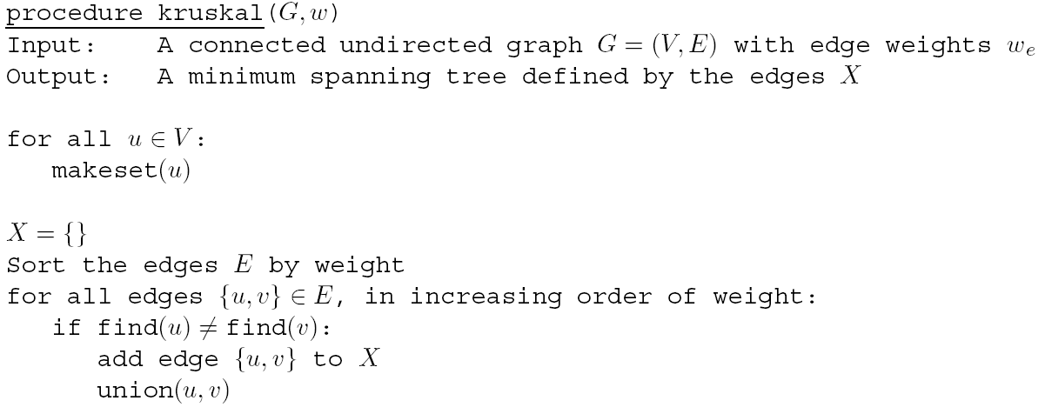
Kruskal's Algorithm
find(u) = find(v) if u and v are in the same set, which means they are in the same connected component
Why not union nodes that are already in the same set?
Represents nodes in disjoint sets
makeset(u): create a singleton set containing just u
find(u): to which set does u belong?
union(u,v): merge the sets containing u and v
Notes:
Again – data structure/alg mix saves the day
Save complexity for later slide
Would create a cycle - Give intuition of union/cycles

Slide 3
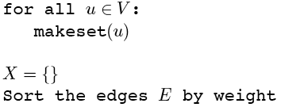
Kruskal’s Algorithm
Make a disjoint set for each vertex
1
2
1
2
3
{1}{2}{3}{4}{5}{6}{7}
6
5
4
4
6
3
8
4
5
6
7
4
3
7
Notes:
Each vertex goes into a separate connected component.
We'll show X on the graph (colored edges), Each color will represent a connected component

Slide 4
Kruskal’s Algorithm
Sort edges by weight
1
2
1
2
3
1: {1,2}
{1}{2}{3}{4}{5}{6}{7}
2: {2,3}
6
5
4
4
6
3: {4,5}
3
8
3: {6,7}
4
5
6
4: {1,4}
4: {2,5}
7
4
3
4: {4,7}
5: {3,5}
7
Notes:
Goal: Visually walk through Kruskal’s algorithm running on this simple graph. This simple enumerates the steps
starting with the sorting.

Slide 5
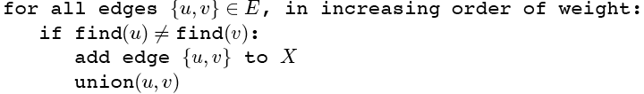
Kruskal’s Algorithm
Add first edge to X if no cycle created
1
2
1
2
3
1: {1,2}
{1}{2}{3}{4}{5}{6}{7}
2: {2,3}
6
5
4
4
6
3: {4,5}
3
8
3: {6,7}
4
5
6
4: {1,4}
4: {2,5}
7
4
3
4: {4,7}
5: {3,5}
7
Notes:
Add the edge with the lowest cost to the solution set X which does not create a cycle.

Slide 6
Kruskal’s Algorithm
Merge vertices in added edges
1
2
1
2
3
1: {1,2}
{1,2}{3}{4}{5}{6}{7}
2: {2,3}
6
5
4
4
6
3: {4,5}
3
8
3: {6,7}
4
5
6
4: {1,4}
4: {2,5}
7
4
3
4: {4,7}
5: {3,5}
7
Notes:
The two vertices that are in the edge are merged into the same connected component

Slide 7
Kruskal’s Algorithm
Process each edge in order
1
2
1
2
3
1: {1,2}
{1,2}{3}{4}{5}{6}{7}
2: {2,3}
{1,2,3}{4}{5}{6}{7}
6
5
4
4
6
3: {4,5}
3
8
3: {6,7}
4
5
6
4: {1,4}
4: {2,5}
7
4
3
4: {4,7}
5: {3,5}
7
Notes:
The next following slides show who each edge is added to T. The issue of always merging separate connected
Components is delayed until we try to add an edge that creates a cycle.

Slide 8
Kruskal’s Algorithm
1
2
1
2
3
1: {1,2}
{1,2}{3}{4}{5}{6}{7}
2: {2,3}
{1,2,3}{4}{5}{6}{7}
6
5
4
4
6
3: {4,5}
{1,2,3}{4,5}{6}{7}
3
8
3: {6,7}
4
5
6
4: {1,4}
4: {2,5}
7
4
3
4: {4,7}
5: {3,5}
7
Note that each set is a connected component of G
Notes:
different color for each non-singleton set/connected component

Slide 9
Kruskal’s Algorithm
1
2
1
2
3
1: {1,2}
{1,2}{3}{4}{5}{6}{7}
2: {2,3}
{1,2,3}{4}{5}{6}{7}
6
5
4
4
6
3: {4,5}
{1,2,3}{4,5}{6}{7}
3
8
3: {6,7}
{1,2,3}{4,5}{6,7}
4
5
6
4: {1,4}
4: {2,5}
7
4
3
4: {4,7}
5: {3,5}
7

Slide 10
Kruskal’s Algorithm
1
2
1
2
3
1: {1,2}
{1,2}{3}{4}{5}{6}{7}
2: {2,3}
{1,2,3}{4}{5}{6}{7}
6
5
4
4
6
3: {4,5}
{1,2,3}{4,5}{6}{7}
3
8
3: {6,7}
{1,2,3}{4,5}{6,7}
4
5
6
4: {1,4}
{1,2,3,4,5}{6,7}
4: {2,5}
7
4
3
4: {4,7}
5: {3,5}
7

Slide 11
Kruskal’s Algorithm
Must join separate components
1
2
1
2
3
1: {1,2}
{1,2}{3}{4}{5}{6}{7}
2: {2,3}
{1,2,3}{4}{5}{6}{7}
6
5
4
4
6
3: {4,5}
{1,2,3}{4,5}{6}{7}
3
8
3: {6,7}
{1,2,3}{4,5}{6,7}
4
5
6
4: {1,4}
{1,2,3,4,5}{6,7}
4: {2,5}
rejected
7
4
3
4: {4,7}
5: {3,5}
7
Notes:
Note that this edge would create a cycle, so it is rejected and not part of T.

Slide 12
Kruskal’s Algorithm
Done when all vertices in one set. Then they are all connected with
exactly |V| - 1 edges. Book version just goes until all edges considered.
1
2
1
2
3
1: {1,2}
{1,2}{3}{4}{5}{6}{7}
2: {2,3}
{1,2,3}{4}{5}{6}{7}
6
5
4
4
6
3: {4,5}
{1,2,3}{4,5}{6}{7}
3
8
3: {6,7}
{1,2,3}{4,5}{6,7}
4
5
6
4: {1,4}
{1,2,3,4,5}{6,7}
4: {2,5}
rejected
7
4
3
4: {4,7}
{1,2,3,4,5,6,7} done
5: {3,5}
7
Notes:
This version of Kruskals will not terminate early but continue until all edges are tried

Slide 13
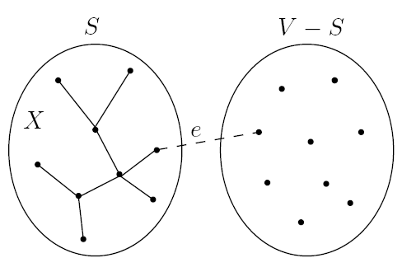
Prim's Algorithm
Prim's algorithm differs from Kruskal's by growing S as a single tree
Intermediate set of edges X always forms a partial MST
X is a set of edges making up the MST and S is the set of vertices
On each iteration, X grows by one edge
Namely the lightest edge between a vertex in S and a vertex outside S
Cannot create a cycle since new vertex not currently in X
What is an efficient data structure to retrieve that edge?
The algorithm is basically Dijkstra's algorithm except that the key value for each node is the lightest incoming edge from S
Notes:
Note X is a set of edges and S is a set of vertices
Argument of just checking if vertex is in X did not used for Kruskals because no fast way to test if edge is already in (e.g. O(v) scan) , whereas Prims does it by keeping vertices in PQ and once popped off, no .

Slide 14
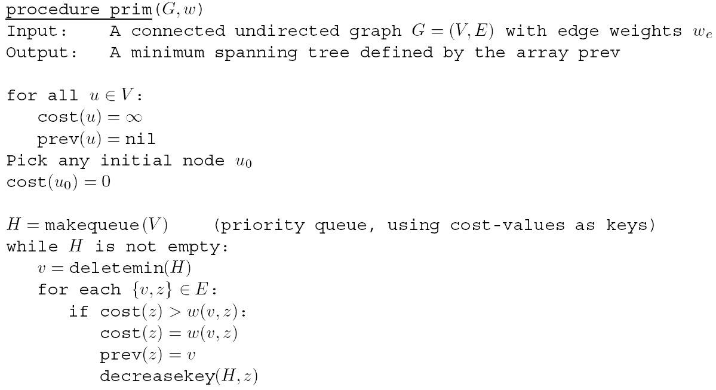
Prim's Algorithm
Decreasekey section does not sum path length, but just updates the key with the decreased edge cost from v to z
Almost same as Dijkstra's Algorithm, same complexity values
Notes:
Key is shortest edge of any node currently in S to any node in V-S
No need to sort first
There is a bug in above alg, since there is no dequeued flag, prev pointers can get sent back wrongly to a node already removed from the queue
Can show it on slide *** currently 37 (when node 2 looks down edge to node 1 and updates nodes 1's cost and prev ptr)
But not the best use of time so don't bring it up unless someone points it out.
Can stop after V-1 iterations – they just keep going

Slide 15
Prim’s Algorithm
Choose arbitrary starting vertex,
set to 0 and deletemin
1
2
1
2
3
S = {5}
1: ∞
2: ∞
3: ∞
4: ∞
5: 0
6: ∞
7: ∞
6
5
4
4
6
3
8
4
5
6
8
4
3
7
Notes:
Goal: Present Prim’s algorithm graphically in a manner similar to Kruskal’s algorithm.

Slide 16
Prim’s Algorithm
Choose arbitrary starting vertex,
set to 0 and deletemin
1
2
1
2
3
X:
S = {5}
1: ∞
2: 4
3: 5
4: 3
6: 8
7: 8
6
5
4
4
6
3
8
4
5
6
8
4
3
7
Notes:
Goal: Present Prim’s algorithm graphically in a manner similar to Kruskal’s algorithm. Initially, consider the light blue edges leaving 5.

Slide 17
Prim’s Algorithm
Do deletemin to
Pick shortest edge leaving S
1
2
1
2
3
X:
S = {5}
{4,5}
1: ∞
2: 4
3: 5
4: 3
6: 8
7: 8
6
5
4
4
6
3
8
4
5
6
8
4
3
7
Notes:
Greedily chosen, this edge will be part of final solution

Slide 18
Prim’s Algorithm
Don’t actually need to store S.
Current PQ is always V - S
1
2
1
2
3
X:
S = {5}
{4,5}
S = {4,5}
1: ∞
2: 4
3: 5
4: 3
6: 8
7: 8
6
5
4
4
6
3
8
4
5
6
8
4
3
7

Slide 19
Prim’s Algorithm
Update then choose shortest cost from
any node in S – node on front of PQ.
Once popped off PQ, will never be
chosen as sink of an edge
1
2
1
2
3
X:
S = {5}
{4,5}
S = {4,5}
1: 4
2: 4
3: 5
6: 8
7: 4
6
5
4
4
6
3
8
4
5
6
8
4
3
7
Notes:
NOT path length, just cheapest one edge cost
Now consider any of the blue edges leaving 4 or 5. Etc. as we add more vertices. Node 7 cost is decreased.

Slide 20
Prim’s Algorithm
Repeat until PQ is empty
1
2
1
2
3
X:
S = {5}
{4,5}
S = {4,5}
2: 1
3: 5
6: 8
7: 4
6
5
4
4
6
{1,4}
S = {1,4,5}
3
8
4
5
6
8
4
3
7

Slide 21
Prim’s Algorithm
Repeat until PQ is empty
1
2
1
2
3
X:
S = {5}
{4,5}
S = {4,5}
3: 2
6: 8
7: 4
6
5
4
4
6
{1,4}
S = {1,4,5}
3
8
{1,2}
S = {1,2,4,5}
4
5
6
8
4
3
7
Notes:
Skip this unless brought up, as it is not the best use of time.
***Note in this case when node 2 checked node 1 which has a key of 4 it would update the cost to 1 (not big deal) AND prev pointer of node 1 would change to node 2 which would be a bug.
Should only test with nodes still on the queue. If added edge immediately into X rather than prev tree at end would have been fine.

Slide 22
Prim’s Algorithm
Repeat until PQ is empty
1
2
1
2
3
X:
S = {5}
{4,5}
S = {4,5}
6: 6
7: 4
6
5
4
4
6
{1,4}
S = {1,4,5}
3
8
{1,2}
S = {1,2,4,5}
4
5
6
{2,3}
S = {1,2,3,4,5}
8
4
3
7

Slide 23
Prim’s Algorithm
Repeat until PQ is empty
1
2
1
2
3
X:
S = {5}
{4,5}
S = {4,5}
6: 3
6
5
4
4
6
{1,4}
S = {1,4,5}
3
8
{1,2}
S = {1,2,4,5}
4
5
6
{2,3}
S = {1,2,3,4,5}
{4,7}
S = {1,2,3,4,5,7}
8
4
3
7

Slide 24
Prim’s Algorithm
Repeat until PQ is empty
1
2
1
2
3
X:
S = {5}
{4,5}
S = {4,5}
6
5
4
4
6
{1,4}
S = {1,4,5}
3
8
{1,2}
S = {1,2,4,5}
4
5
6
{2,3}
S = {1,2,3,4,5}
{4,7}
S = {1,2,3,4,5,7}
8
4
3
{6,7}
S = {1,2,3,4,5,6,7}
7

